Slide 1

Parallel Graph Algorithms
EXPLORING THE EFFICIENCY AND ADVANTAGES OF PARALLEL PROGRAMMING FOR GRAPH ALGORITHMS.

Slide 2
GRAPH THEORY
COMPLEXITY
Graph theory is the foundation of computer science and math, helping solve real-world problems.
It's used in various areas like social networks, transportation, biology, and computer networks.
Large graphs come with tough math problems.
More data and complexity mean we need new ideas.
Parallel graph algorithms offer a smart way to solve these problems.
PARALLEL GRAPH ALGORITHMS
Parallel graph algorithms are designed to speed up operations on large and complex graph structures by using multiple processors.

Slide 3
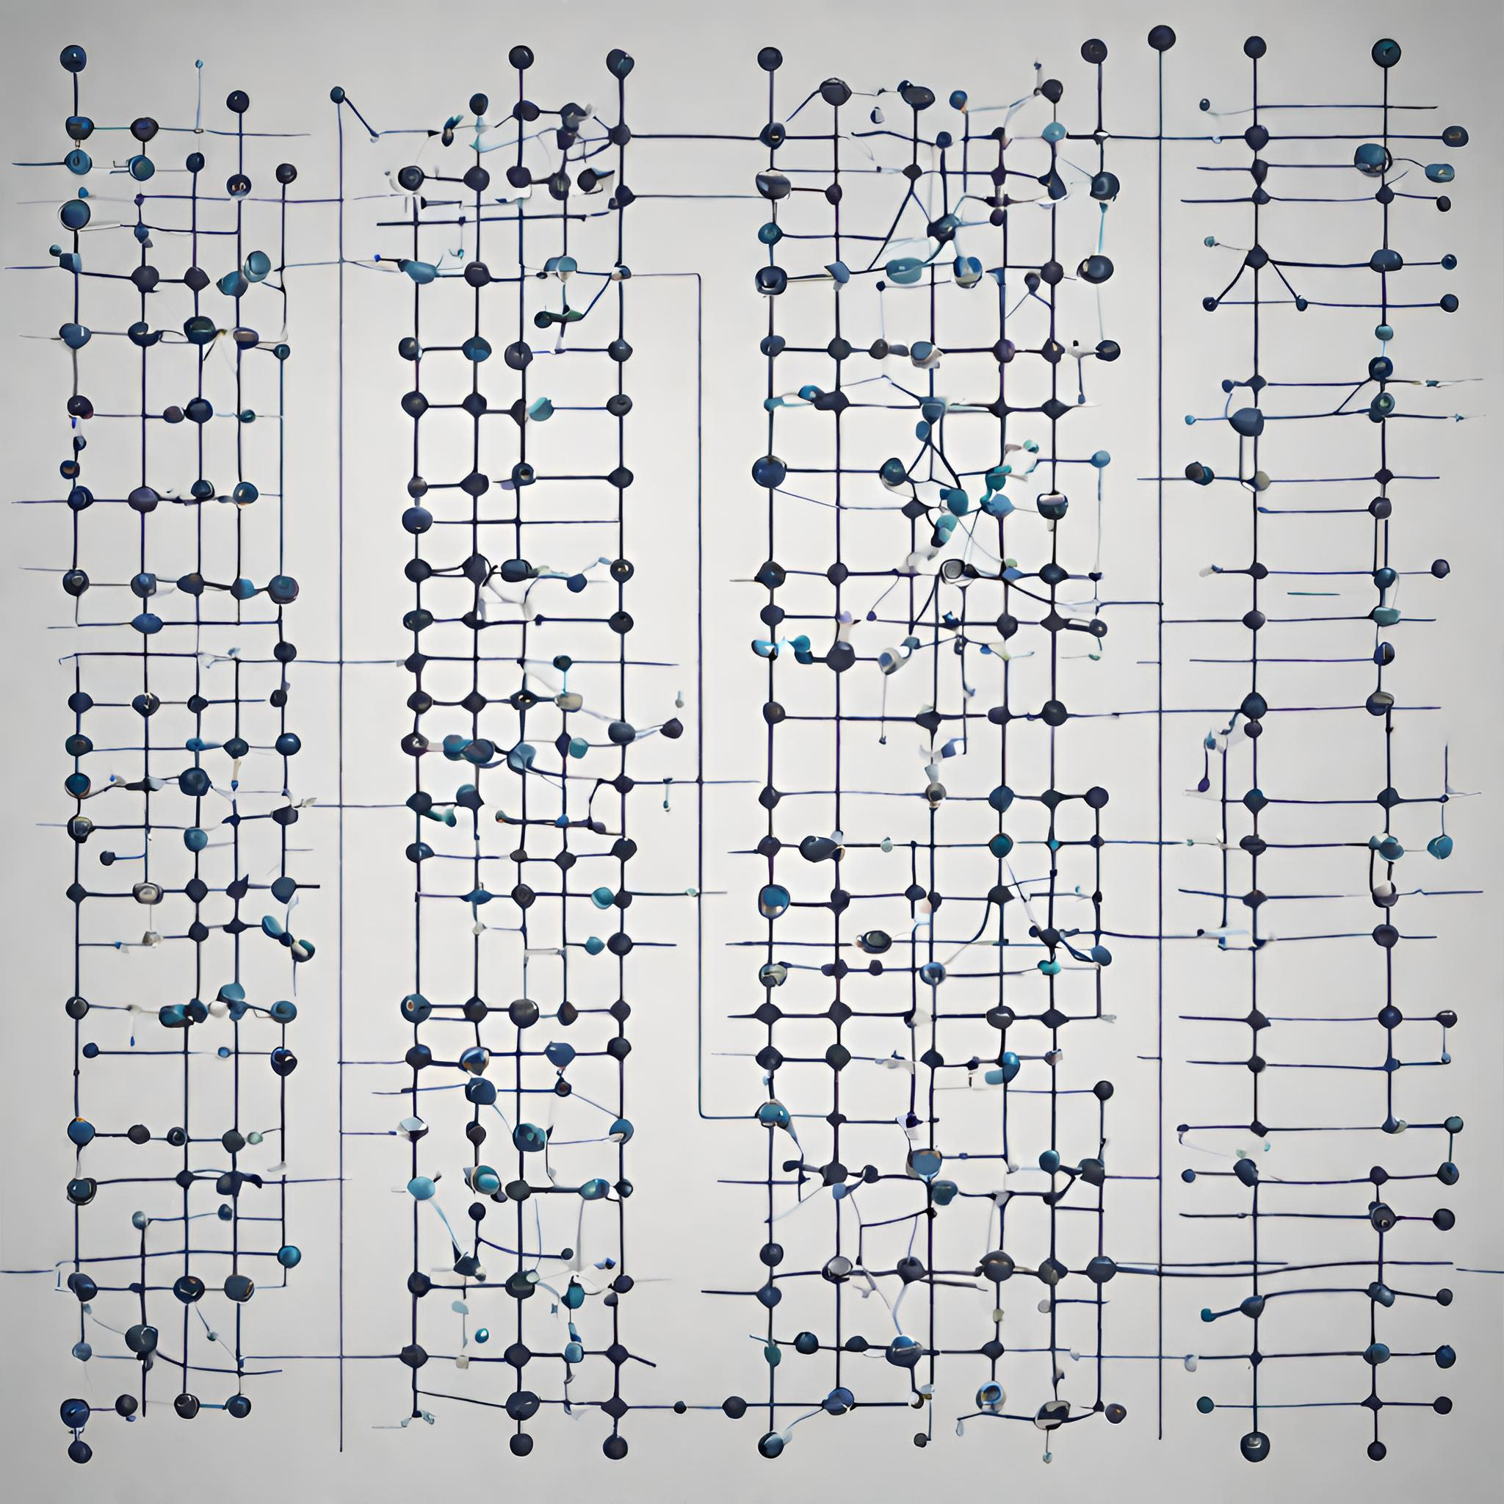
Parallel Graph Algorithms
1
2
3
Parallel graph algorithms are designed to expedite operations on large and complex graph structures.
They utilize multiple processors, resulting in faster processing and improved efficiency.
These algorithms are essential for various applications, from big data analysis to social network exploration.
4
5
6
Their scalability and cost-effectiveness make them a valuable resource in the era of extensive data.
In addition to speed, parallel graph algorithms offer increased overall data processing efficiency.
They find wide applications in fields such as data analysis, social network analysis, pathfinding problems, and network security.

Slide 4
Related Works
1
2
3
BFS AND DFS
ALGORITHMS
SHORTEST PATH ALGORITHMS
PARALLEL GRAPH PARTITIONING
It is particularly valuable for data analytics and network discovery when working with graph data.
Correct route calculations in data sets are of fundamental importance to determine the most efficient routes within networks.
Splitting graph data into components is critical for parallelizing data and accelerating analysis processes.

Slide 5
Parallel vs Sequential
BFS AND DFS ALGORITHMS
Sequential BFS and DFS process graph data sequentially on a single processor, which can be slow for extensive graph data.
Parallel BFS and DFS, on the other hand, swiftly scan large graph data by utilizing multiple processors, providing faster results, particularly for data analysis and network exploration.
SHORTEST PATH ALGORITHMS
Sequential shortest path algorithms compute the shortest path for each node by step-by-step traversal, which can be slow for substantial networks.
Parallel shortest path algorithms accelerate these calculations by working simultaneously on multiple processors, making them more effective, especially for extensive networks.
GRAPH PARTITIONING
Sequential graph partitioning can be time-consuming for large graph data as it divides the graph sequentially.
Parallel graph partitioning, using multiple processors, quickly divides the graph into sections, which is preferred for data parallelization and speeding up analysis procedures in large graph data.

Slide 6

Advantages of Parallel Graph Algorithms
Efficiency: Parallel graph algorithms enhance computational efficiency, reducing processing times.
Speed: They work faster with multiple processors.
Big Data Handling: Ideal for large datasets.
Resource Optimization: Maximizes computing resources.
Future-Ready: Effective solutions for upcoming data challenges.
In summary, parallel graph algorithms offer efficient, speedy, and scalable solutions for data analysis, network exploration, and graph analysis, addressing the challenges of increasing data volumes.

Slide 7
Methodology
Comprehensive comparison of parallel and sequential graph algorithms.
SELECTION CRITERIA
MEASUREMENTS
ENVIRONMENT
BFS and DFS chosen for efficiency in large-scale graph processing.
Processing time
Speedup
Efficiency
Multiprocessing environment to simulate parallel processing.

Slide 8
Results
1
2
Evaluated the performance of parallel and sequential DFS and BFS algorithms.
Analyzed the efficiency of parallel graph algorithms.

Slide 9
PERFORMANCE ANALYSIS OF DFS ALGORITHMS
SEQUENTIAL DFS
PARALLEL DFS
Average Time: 0.004 seconds
Consistent Performance
Reliable for large-scale graph processing tasks
Average Time: 0.001 seconds seconds
Remarkable Efficiency Improvements
Specific executions completed instantly (0.000 seconds)
Immense potential for large-scale graph exploration

Slide 10
PERFORMANCE ANALYSIS OF BFS ALGORITHMS
SEQUENTIAL BFS
PARALLEL BFS
Average Time: 0.002 seconds
Consistent Performance
Suitable for extensive graph analysis tasks
Average Time: 0.001 seconds
Outperforms Sequential BFS
Substantial potential for accelerating graph analysis operations

Slide 11
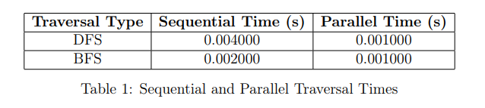
Comparative Analysis
FINDINGS
NOTE
Execution Time Reduction
The skillful utilization of parallel processing.
Hopeful way for large-scale graph analysis.
Parallel algorithms consistently efficient.
Parallel executions with 12 threads.
Careful and efficient utilization of computational resources.
KEY TAKEAWAYS
Parallel DFS and BFS algorithms show significant advantages over sequential counterparts.
Efficient utilization of computational resources in large-scale graph analysis.

Slide 12
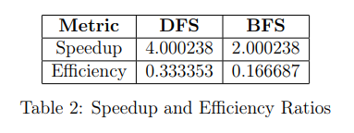
Conclusion
Success in Efficiency
Practical Impact
Parallel BFS/DFS consistently outperforms sequential.
Accelerated graph analysis observed.
Validated practicality in real-world scenarios.
Solutions for data analytics, network exploration, biology.
Future Outlook
Implementation Insights
Closing Thoughts
Recognized limitations, focus on generalizability.
Ongoing work offers promise for advancements.
Realistic and feasible in various domains.
Addresses challenges in data analytics, network exploration.
Efficient, applicable, and promising.
Sets stage for further advancements.

